Slide 1
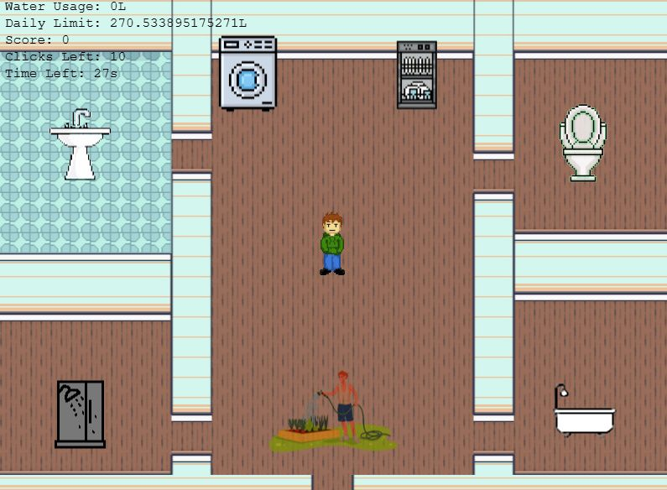
Water Trekkies
Family friendly game (G-rated) to compete for household water consumption High Score!

Slide 2

Project 2 Team 5
Danielle Barker: ScrumMaster. InceptionU Expert at large.
Jenna Kersch: Gaming Full-Stack Developer. Phaser expert. Team expert on gaming. Trello Project Manager. Water Trekkie Game will be added to her new Gaming Studio Portfolio. ChatGPT expert.
Hank Yi-Hsueh Chen: Full-Stack Developer. ChatGPT Magician.
Sarfraz Qazi: Full-Stack Developer, Researcher, Platform Quality Assurance. ChatGPT expert.
Karen Kwong: Full-Stack Developer. Traditional software engineering – ChatGPT/AI wins. Nominal gaming experience – I ruined a Christmas 🎁 Nintendo Wii excitement for little cousins by explaining the engineering behind the game.
SQ

Slide 3



Did you enjoy the 2024Spring/Fall City of Calgary Water Ration? Did you learn new ways to use/reuse/recycle water? … “If it’s yellow, let it mellow. If it’s brown, flush it down.”
Water Trekkies Game is a fun way to teach your children & friends how to help keep your household water consumption low … and keep them distracted for a while …
SQ

Slide 4



Goal
Use City of Calgary’s Open Data for water to create a useful public app.
Make water conservation education fun.
Use City of Calgary’s historical data “Water Single Family Consumption” as a benchmark to Gamer’s achievement.
Overcome one of the biggest challenges of being environmentally friendly – adopting green-practices at home in daily life.
Make water consumption best practices fun.
SQ

Slide 5

Welcome … Water Trekkie Game!
First of its kind, the prefect G-Rated family friendly game that will teach you and family how to claw back money from water Utilities.
Educate young children how to contribute to household water savings – good water best practices.
In the Game, you compete against the City household average water consumption.
In the Game, your Avatar executes water saving tasks to beat the clock and the City household water consumption average.
SQ

Slide 6






Bonus
Use the Water Trekkie Game as an educational virtual babysitter (any age …) … while you’re shopping, waiting in line, enjoying coffee with friends … anytime, anywhere – just pull the game up on your laptop.
Nominal data usage.
Environmentally friendly – love Earth.
SQ

Slide 7
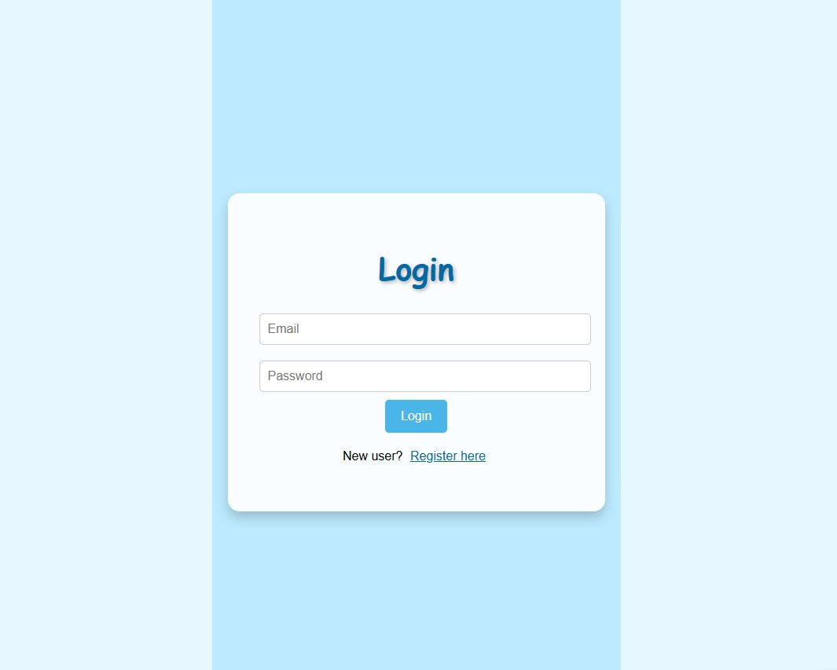
Water Trekkie Game UI
Login: Setup to track Player’s High Score.
Register Here: New Player? This is the link for you!
Note: Password is encrypted!
JK

Slide 8
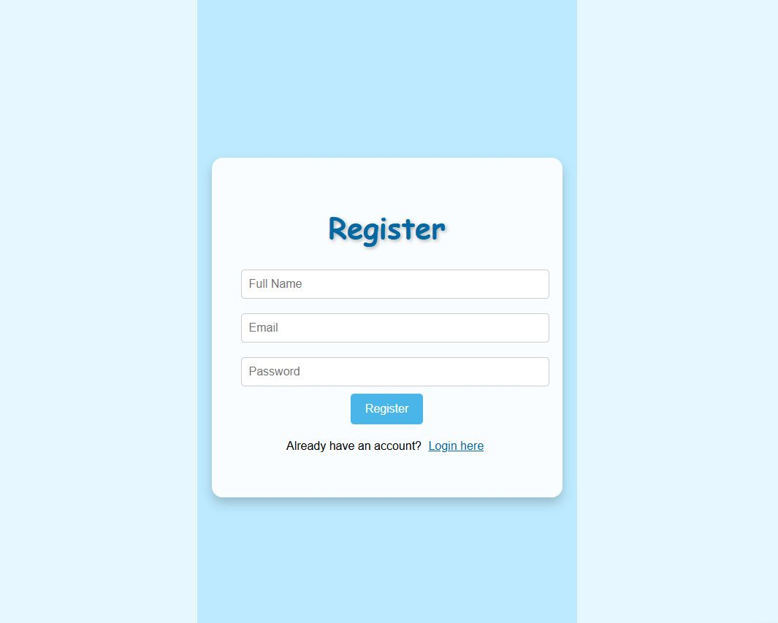
New Player
Registration: Create new Player login.
JK

Slide 9
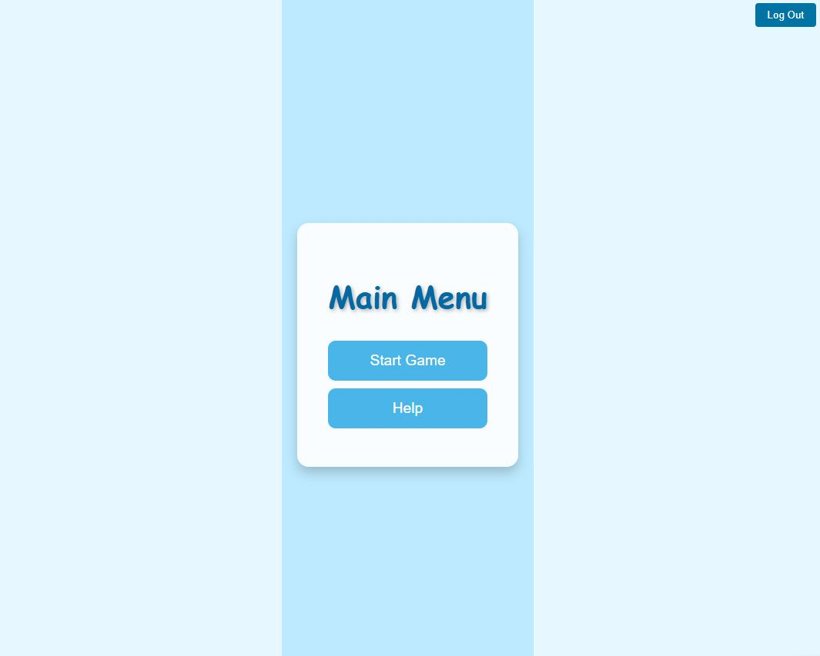
Game Main Menu
Start Game: Player One begin!!
Help: Learn about the Water Trekkie Game.
LogOut: End Game.
JK

Slide 10
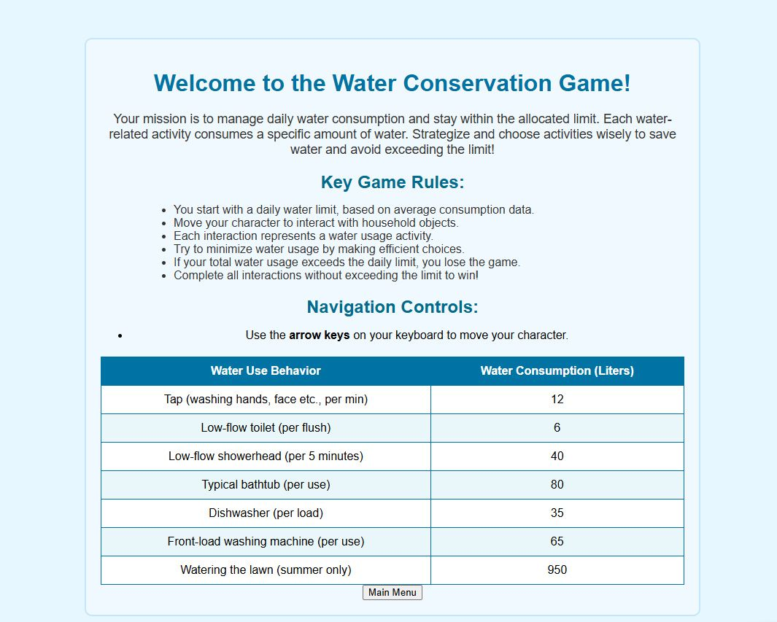
Help
Learn about game rules and what the Player Avatar can do.
Learn about the different game levels of difficulty.
Learn about the City Water average per household.
Learn how much H2O household water appliances consume.
JK

Slide 11
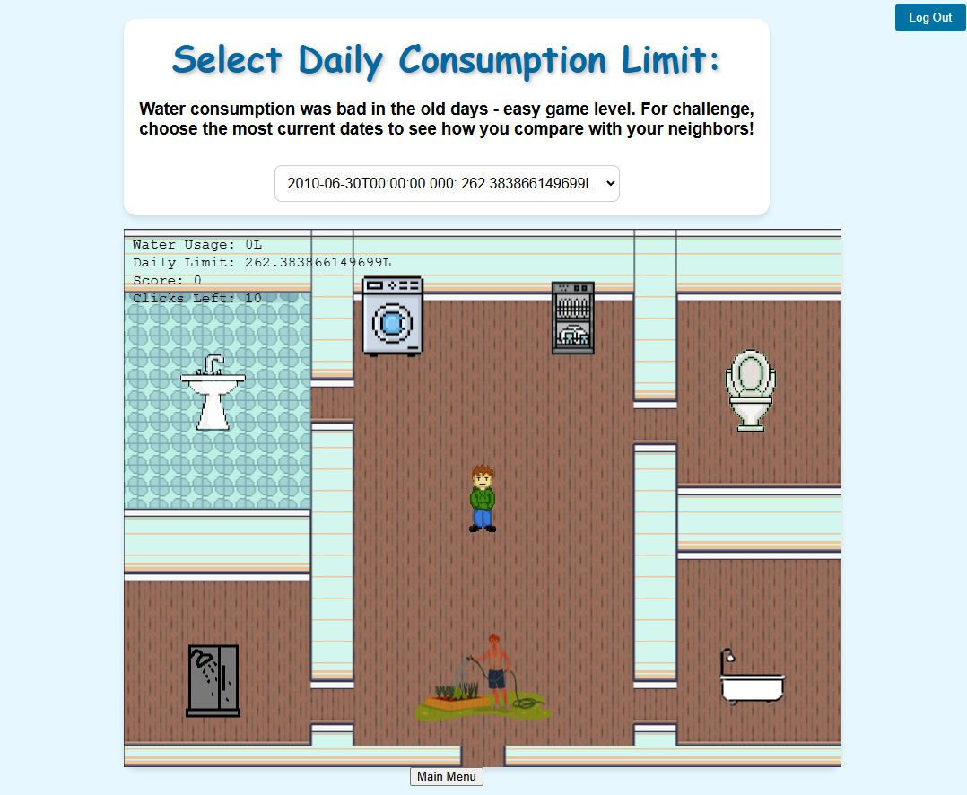
The Game!
Your mission should you accept this challenge is to consume less water than the City household average for the Level/Date you choose.
Consumption Limit: Level of difficulty.
Main Menu: Return to Game’s Main Menu.
Logout: End Player One.
Ready Player One!
JK

Slide 12

Live Demo
Ready Player One … begin and good luck!
JK

Slide 13
Our Journey
Initial brainstorming Project 2 concept: Reflecting on 2024 Summer water pipeline issues, considered analyzing City water pipeline problem neighborhoods based on type and age of currently installed pipelines – already DONE.
Resulting Project 2 Goal: Gamify water conservation best practices while producing beta version of Water Trekkies Game - product of Jenna’s Gaming Studios.
HC

Slide 14
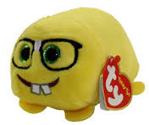

Challenges
Incorporating limited City Water Data in a Citizen useful app that hasn’t already been done.
How to make water data sexy?
Non-gamer team members …
1 team member was away for 2 critical wks out of project’s 6 wks – normal project events.
Learning curve of Phaser and Cor Javascript gaming libraries – outside of COHORT13 scope.
React & Express was scheduled AFTER Project2 introduction so we felt we lost 2 wks of learning it. If part of Project2 was learning to re-factor mid-project due to change requirements, lesson learned.
ChatGPT generated code incoherent with other chunks of code.
Learning to use ChatGPT generated code without fully understanding it – proof that it works timely and efficiently. AI wins!
Customizable Avatars – Alpha version has been implemented but ran out of time to integrate it.
High Score tracking – broken code.
Arrows required for Avatar navigation.
HC

Slide 15

Lessons Learned
Don’t skip COHORT13 Instructor lead classes and must supplement class material with online educational apps ie. W3Schools, Codecademy, Free Code Camp, Youtube, Google, etc.
Npm run dev CTRL-SHIFT-I
Learn GitHub Branching, Rollback, Merge.
Be prepared for potential 180 degrees design redirection.
Learning that, “Change should be uncomfortably comfortable.” –Jenna-
Front-end to Back-End React – Express – MongoDB 1st project.
Phasor & Cor & the wealth of open source Javascript libraries available thanks to Software Developer Heroes around the world.
Code more to improve speed because AI is faster than you.
KK

Slide 16
Future Potential
Partnerships for high score achievement incentives.
Utilities incentive plan/rebate to reward people with excellent water consumption best practices.
Jenna’s Gaming Studio will be expanding the Water Trekkie Game adventures.
New challenges.
Customizable Avatars – Alpha version has been implemented but ran out of time to integrate it.
Bells and whistles.
When your family applies the game’s water best practices, pocket your water utility savings and help keep Earth’s acquarium healthy.
Add marketing game trailer to home page.
Partner with utility companies – options are endless.
Friendly competition for High Score with other Calgarians.
KK

Slide 17
Conclusion
Being “water-wise” means learning better water consumption habits. Start your spawn on water best practices and pocket your water utilities savings.
Water Trekkie Game – your educational yet fun virtual babysitter.
Compete with other Calgarians to achieve high score bragging rights!
Watch for game expansion and enhancements in the near future from Jenna’s Gaming Studio.
KK

Slide 18

Q & A
What game enhancements would you like to play?
Ready to try for the Calgary Water Trekkie High Score?
KK
Segway to bloopers …

Slide 19

Bloopers
Q: Did you consider adding a Login to your Project 2 with Password encryption but … it got complicated? A: ChatGPT took care of that for us – mongoose-bcrypt.
AI Experiment: ChatGPT Honorary Team5 FullStack Developer
This presentation is a demo of clever marketing.
KK

Slide 20
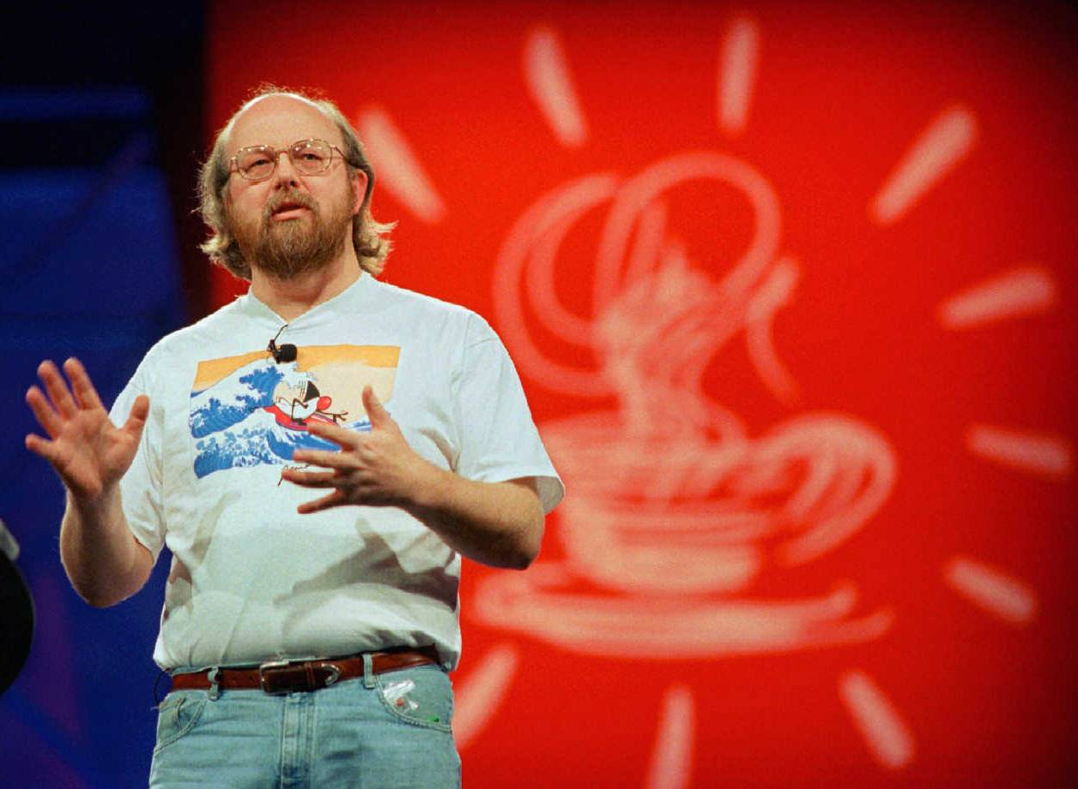
Tribute To Calgarian James Gosling
Inventor of Java – back-end web design.
SQ

